Slide 1
Life Expectancy
This study focuses on mortality factors, economic factors, social factors and other health related factors that affect life expectancy
In this study we have considered data from year 2000-2015 for 160 countries for our analysis.

Slide 2
Aim :
Does various predicting factors which has been chosen initially really affect the Life expectancy?
What are the predicting variables affecting the life expectancy?
How does Adult mortality rates affect life expectancy?
What is the impact of schooling on the lifespan of humans?
Suggest a country which area should be given importance in order to efficiently improve the life expectancy of its population
Encourage people to invest the time, energy, and money that make health a very high priority.

Slide 3
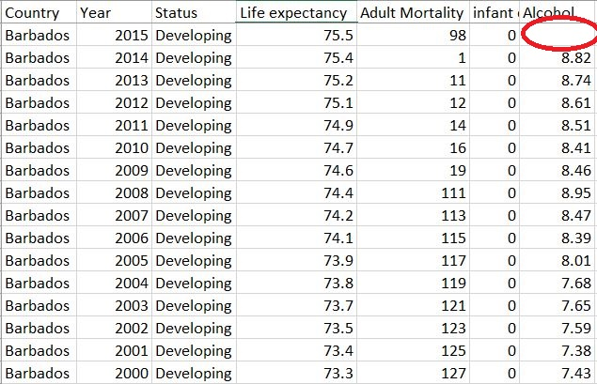
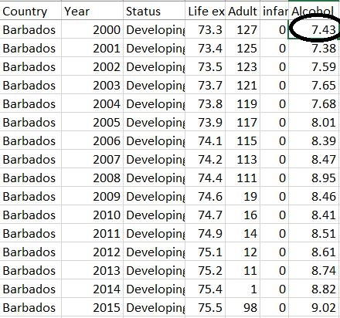
Pre-Processing
Dropped the countries containing missing values for Life Expectancy
Dropped the Hepatitis column containing large number of missing values and inconsistent data
Moving Average in Alcohol, Total Expenditure & Schooling to treat missing values.

Slide 4
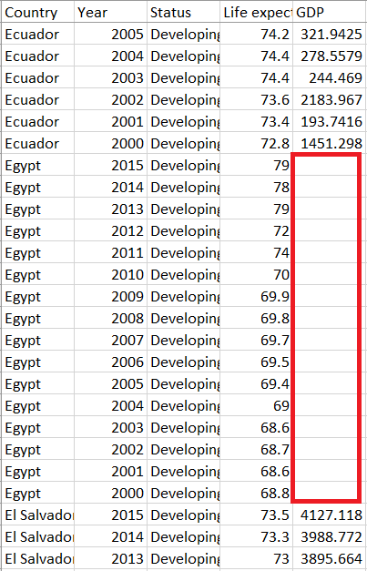
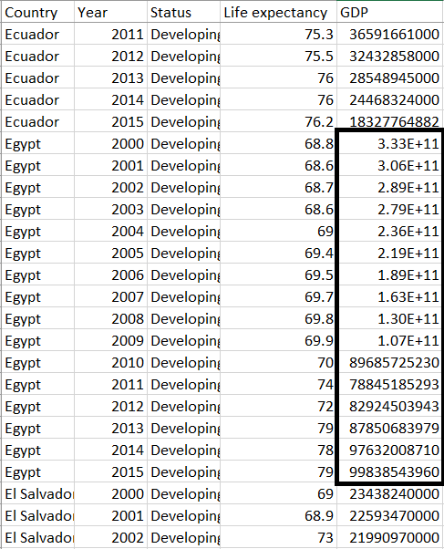
Data Scrapping to fill null values in GDP
Used Data Scrapping to replace the inconsistent data of percentage expenditure for all countries between 2000 to 2015
Introduced a new column for population of countries

Slide 5
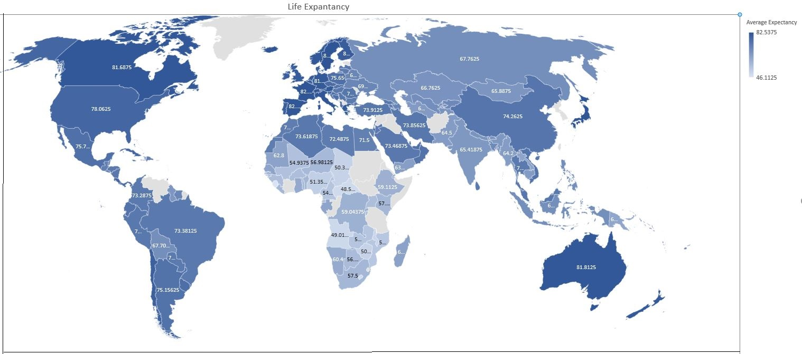
Exploratory Data Analysis – Average Life Expectancy Map
Recommendations for countries having lower Life Expectancy:
Improvements in healthcare and welfare of people.
Increasing the percentage expenditure on healthcare.
Focusing on better Education in the country
Countries with high average life expectancy
Countries with average life Expectancy below 60
countries belonging to European continent tends to have higher Life Expectancy while countries belonging to African Continent tends to have lower Life Expectancy

Slide 6
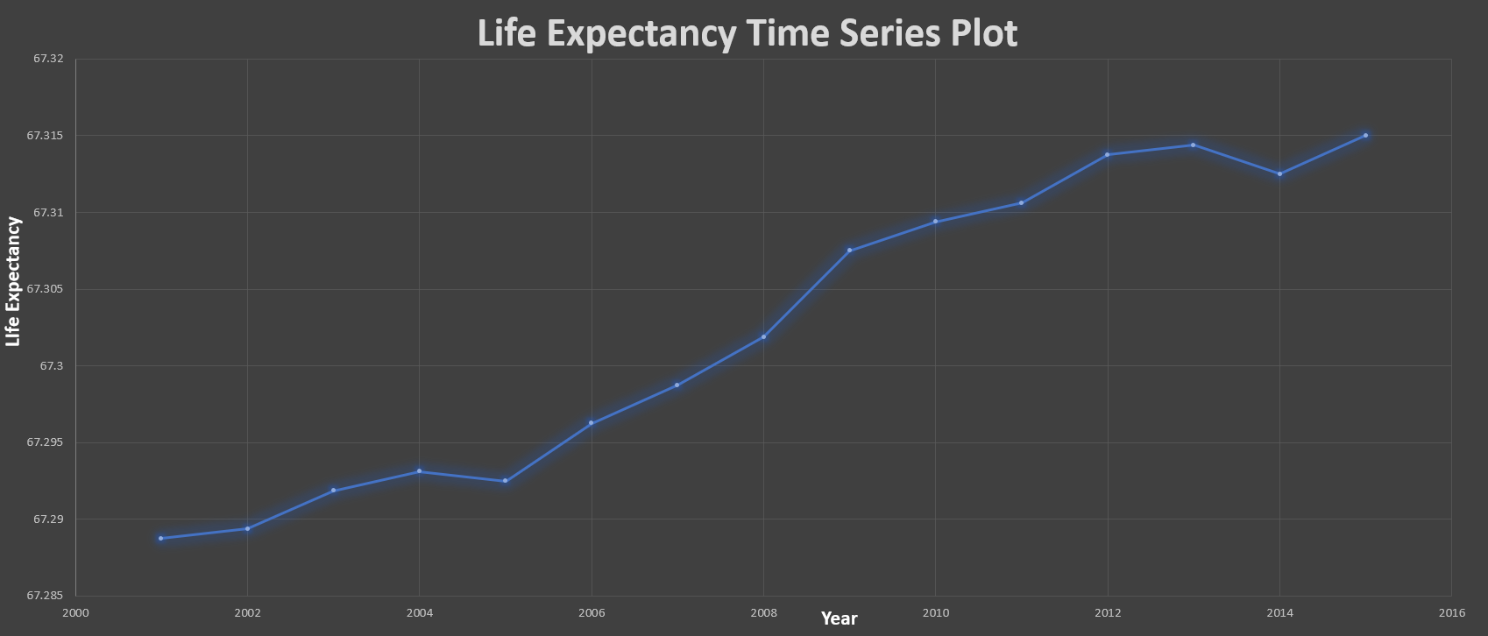
Exploratory Data Analysis – Time Series Plot
Average life expectancy in the world gradually increased overtime.

Slide 7
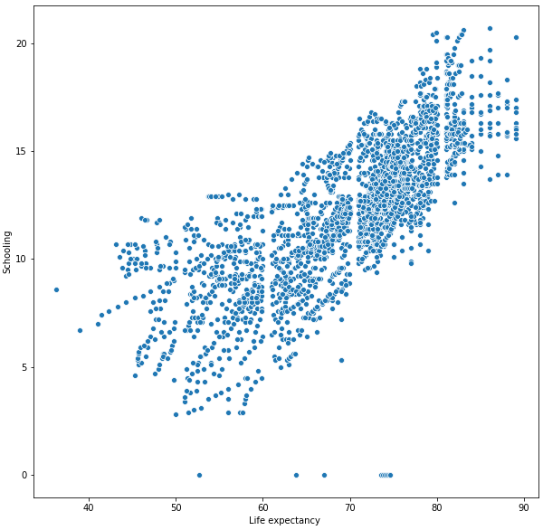
Exploratory Data Analysis
Developed countries have bit higher life expectancy on an average than developing countries
Life Expectancy is positively correlated with Schooling index of population for any given country through which it can be concluded that education plays an important role . Thus, population of any country with higher schooling index tends to have higher life expectancy.

Slide 8
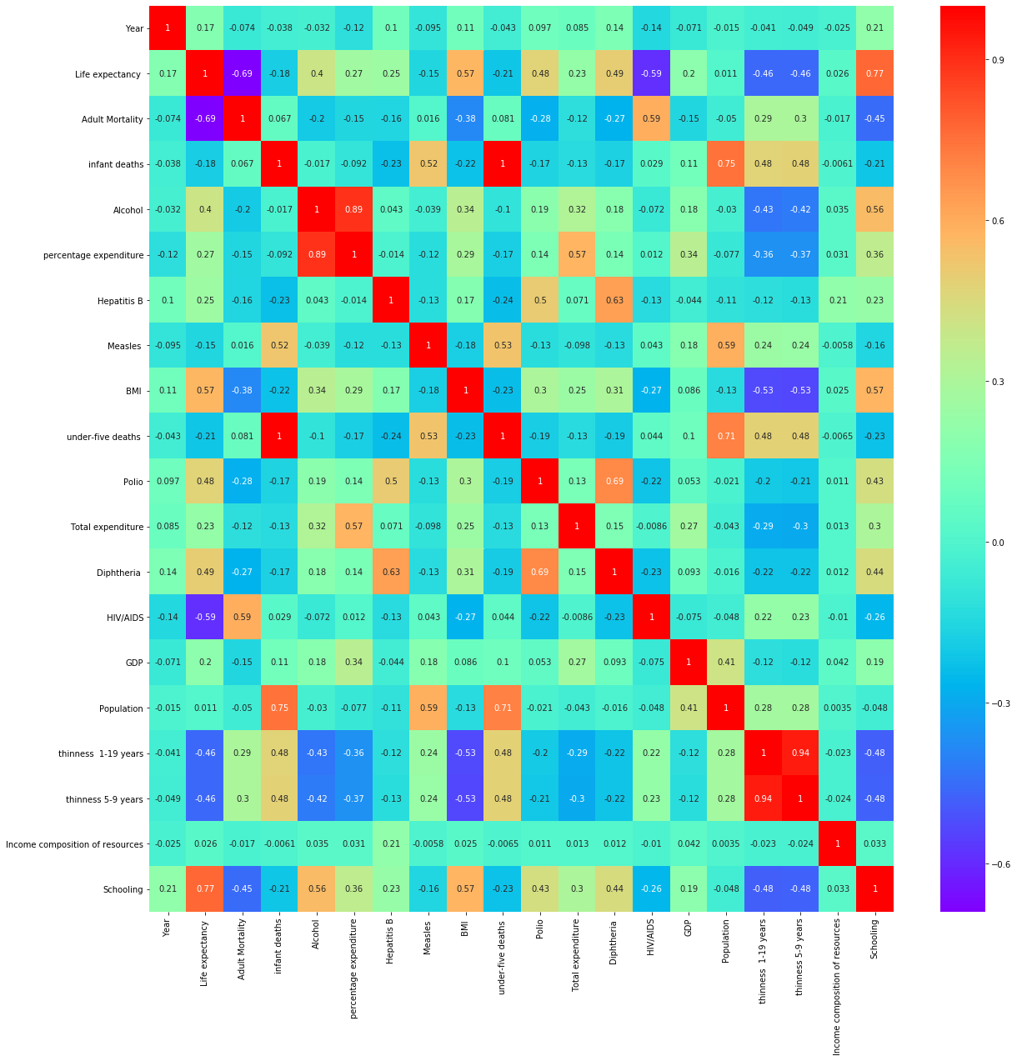
Correlation Heatmap

Slide 9
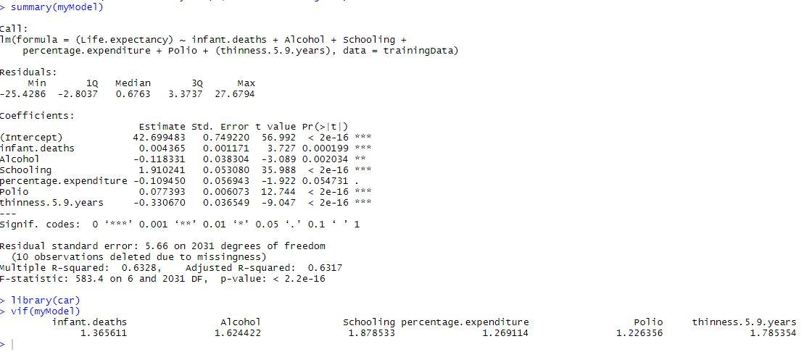
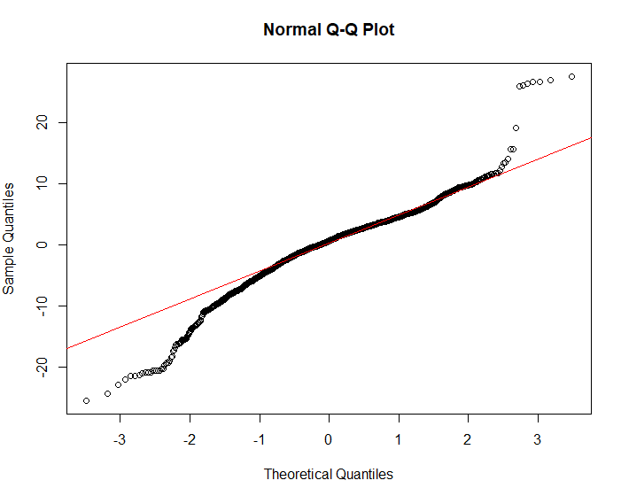
MODEL 1 :
All p-values < alpha(0.05)
All vif < 5, shows no Multicollinearity
Adjusted R-Squared values was good enough
Violating assumption of Normality of Errors

Slide 10
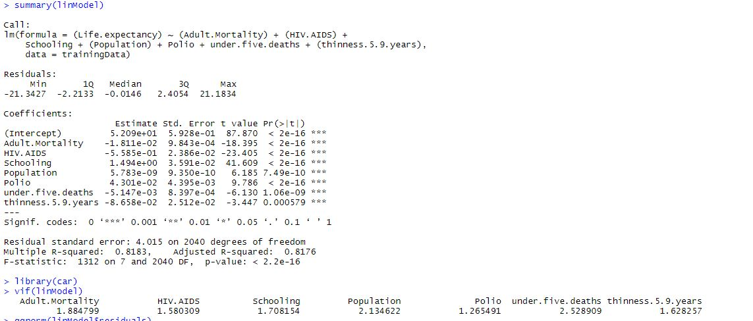
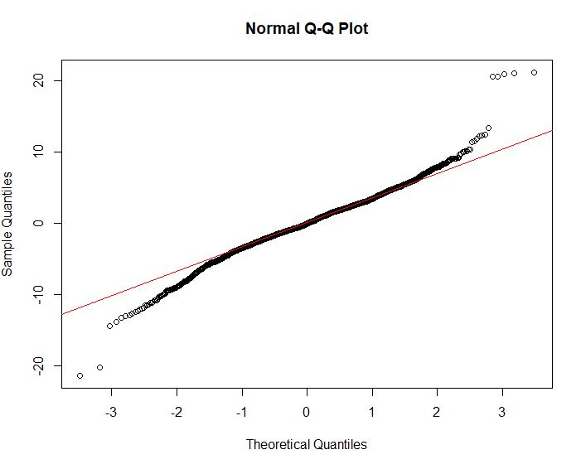
MODEL 2 :
Adjusted R-Squared values was good enough
All p-values < alpha(0.05)
All vif < 5, shows no Multicollinearity
Violating assumption of Normality of Errors

Slide 11
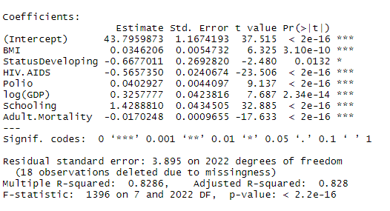
MODEL
Adjusted R Square
Life. Expectancy = 0.035*BMI - 0.668*Status + 0.5657*HIV.AIDS + 0.04*Polio + 0.3258*log(GDP) + 1.489*Schooling - 0.017Adult.Mortality

Slide 12
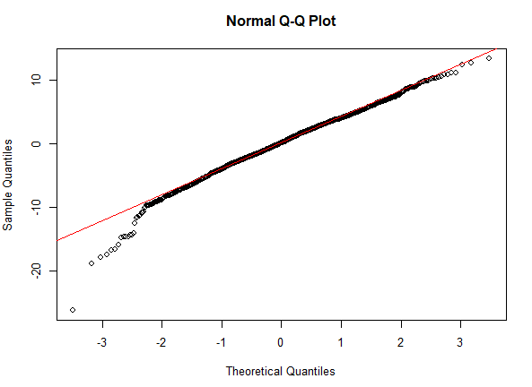
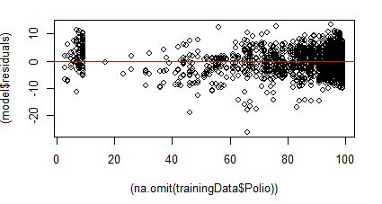
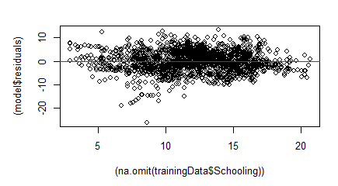
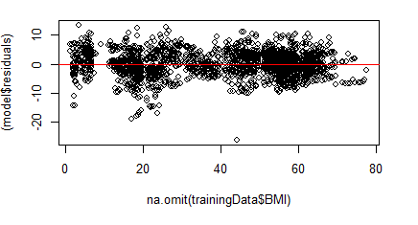
Validating Assumptions

Slide 13
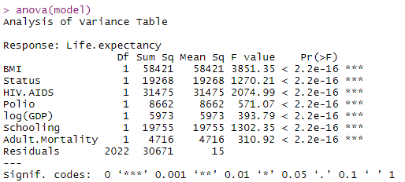


All vif less than 5, shows no multi-collinearity
PERCENTAGE ERROR

Slide 14
Recommendations:
Healthcare improvements like the introduction of vaccines, the development of drugs or positive behavior changes like the reduction in smoking or drinking rates.
Urge countries to adopt policies and programs to promote population-wide interventions like reducing salt in processed foods, cutting dietary fat, encouraging exercise and higher consumption of fruits and vegetables and lowering smoking to improve BMI.
Countries can allot larger share of their total expenditure on healthcare in order to increase the life expectancy of its population

Slide 15
Thank You

